Slide 1
Current Outlook on Ohio Vegetation Management
Lowell K. Miller
Facilities and Operations Field Division (FOFD)
Service Monitoring and Enforcement Dept. (SMED)
Public Utilities Commission of Ohio (PUCO)

Slide 2
Overview
What is a Public Utility?
PUCO Regulated Electric Utilities
Facility Operations Field Division Mission Statement
Scope of Jurisdiction
Authority to Inspect and Audit
Inspection and Maintenance Requirements
Annual System Improvement Plan Report
Analysis and Assessment
Call Center Education
Field Audits and Investigations
Office Audits

Slide 3
What is a public utility?
Every corporation, company,…..including any public utility that operates its utility not for profit, except the following:
  An electric light company that operates its utility not for profit
  A public utility that is owned or operated by any municipal corporation
Ohio Revised Code ORC 4905.02
Notes:
The Ohio law defines a public utility as-

Slide 4
Electric Utilities the PUCO Regulates
FirstEnergy - Cleveland Electric Illuminating Company
- Ohio Edison Company
- Toledo Edison Company
Dayton Power & Light
Duke Energy Ohio
AEP Ohio - Ohio Power Company
Notes:
The PUCO currently regulates these electric utilities

Slide 5
Notes:
Map depicting Ohio regulated electric utilities

Slide 6
FOFD Mission Statement
To regularly inspect utility facilities and review plant operating practices to ensure regulated utility service providers deliver safe, reliable, and quality service.
Notes:
Our mission is to ensure the regulated electric utilities provide safe, reliable and quality service.

Slide 7
Scope of Jurisdiction
The PUCO is vested with the power and jurisdiction to supervise and regulate public utilities
A PUCO employee may enter in, or upon and inspect any property and all associated materials of any company regulated by the PUCO
ORC 4905.04, 4905.05
Notes:
Ohio law allows

Slide 8
Authority to Audit and Inspect
Ohio Revised Code (ORC)
Ohio Administrative Code (OAC)
National Electrical Safety Code (NESC)

Slide 9
NESC
OAC mandates that electric utilities comply with NESC
Ohio Administrative Code (OAC 4901:1-10-06)
Notes:
4901:1-10 commonly referred to as Electric Service and Safety Standards or ESSS rules. Each electric utility shall comply with the "National Electrical Safety Code" approved by the "American National Standards Institute" and adopted by the "Institute of Electric and Electronics Engineers."

Slide 10
NESC Requires Vegetation Management
Vegetation that may damage ungrounded supply conductors should be pruned or removed
NESC 218. A. 1
Notes:
As related to vegetation management and control, section 218 of the NESC requires

Slide 11
Inspection, Maintenance, Repair and Replacement of Electric Distribution Facilities
  Each electric utility shall establish, maintain, comply with:
  Written programs, policies, procedures, and schedules for the inspection and maintenance of its distribution circuits.
  OAC 4901:1-10-27
Notes:
ESSS Rule 27 requires electric utilities to establish written programs and schedules for seven specific distribution maintenance programs.

Slide 12
Required Maintenance Programs
(a) Poles and towers.
(b) Circuit and line inspections
(c) Primary enclosures (e.g., pad-mounted transformers and pad-mounted switch gear) and secondary enclosures (e.g., pedestals and handholes)
(d) Line reclosers
(e) Line capacitors
(f) Right-of-way vegetation control
(g) Substations
OAC 4901:1-10-27
Notes:
Right of way vegetation is one of the seven required programs.

Slide 13
Annual System Improvement Plan Report
Budgeted and actual reliability-specific capital and maintenance expenditures
Description of current distribution inspection and maintenance programs
Goals of distribution inspection and inspection programs and whether the goals were achieved
OAC 4901:1-10-26
Notes:
On or before March 31 of each year, electric utilities are required to file an annual report describing the previous year’s quality, safety and reliability of their distribution service. Highlights include:

Slide 14
Rule #26
2018
Electric Service and Safety Standards
Program name | Explanation of how goal was achieved | Description of extent of achievement | Quantitative description of goal in either numerical values or percentages | Quantitative description of actual performance in either numerical values or percentages
Distribution Vegetation Management Goal – Achieve 4-year cycle for vegetation line clearing on distribution circuits. Complete an average of 25% of target circuit miles per year. (2018) | Distribution vegetation line clearing was completed for 2018 with 2,412.6 miles completed in 2018. | Full vegetation line clearing was completed on 2,412.6 miles in 2018 toward the 4-year cycle goal. | Full vegetation line clearing was completed on 27.1% of the 8,890 distribution circuit miles in 2018 toward the 4-year cycle goal. | 2,412.6 circuit miles of line were cleared in 2018. 108.5% of the average annual mileage target.

Slide 15
Analysis and Assessment of Vegetation Management Program
Program Implementation Measures:
Goals or cycle met
Circuits or mileage trimmed
Program Effectiveness Measures:
Number of outages caused by trees
Percent of outages caused by trees
Notes:
Based on review of outage cause and duration, staff determines the effectiveness of veg management program

Slide 16
2018
Number of customers interrupted:
Equipment/Hardware Failures
Trees Outside ROW
Distribution Station
Unknowns (Weather & Non-Weather)
Vehicle Accidents
Trees Inside ROW
Animal/Bird
Lightning
High Wind

Slide 17
2018
Number of customer minutes interrupted:
Equipment/Hardware Failures
Trees Outside ROW
Distribution Station
Trees Inside ROW
Unknowns (Weather & Non-Weather)
Vehicle Accidents
Lightning
High Wind
Animal/Bird

Slide 18
2018
Overall impact to customers:
Equipment Failures
Trees Outside ROW
Distribution Station
Unknowns (Weather & Non-Weather)
Vehicle Accidents
Trees Inside ROW

Slide 19
Vegetation Related Contacts to the PUCO Call Center
Consumer contacts related to vegetation issues,
December 1, 2018 through November 30, 2019: 165
Notes:
The PUCO maintains a call center staffed by ?? # personnel to handle complaints, inquires, and requests.

Slide 20
Common Complaints
Trees “butchered”
Trimmed too much
Did not remove debris after storm restoration
Trimmed outside the ROW
Did not notify prior to trimming
Refused to trim around telephone or cable lines
Did not give permission to enter property
Damaged property
Notes:
Common concerns and complaints include

Slide 21
Call Center Response
Education, cite ORC, OAC and electric utility tariffs as appropriate
Request a written response from the electric utility (informal complaint)
Confer with staff electric specialist
Possible on-site visit with field staff
Provide consumer with formal complaint packet
  The PUCO does not award damages
Notes:
The call center staff attempts to educate consumers as it relates to trimming issues by citing

Slide 22
Field Audits and Investigations
Duties include:
Independent line clearance inspections
Observing crews performing vegetation management activities
Observing permitting/planning activities
Conducting line clearance audit with electric utility forester
On site visits related to vegetation management issues
Notes:
The PUCO employs five experienced personnel to perform physical audits and inspections on a daily basis throughout the state.

Slide 24
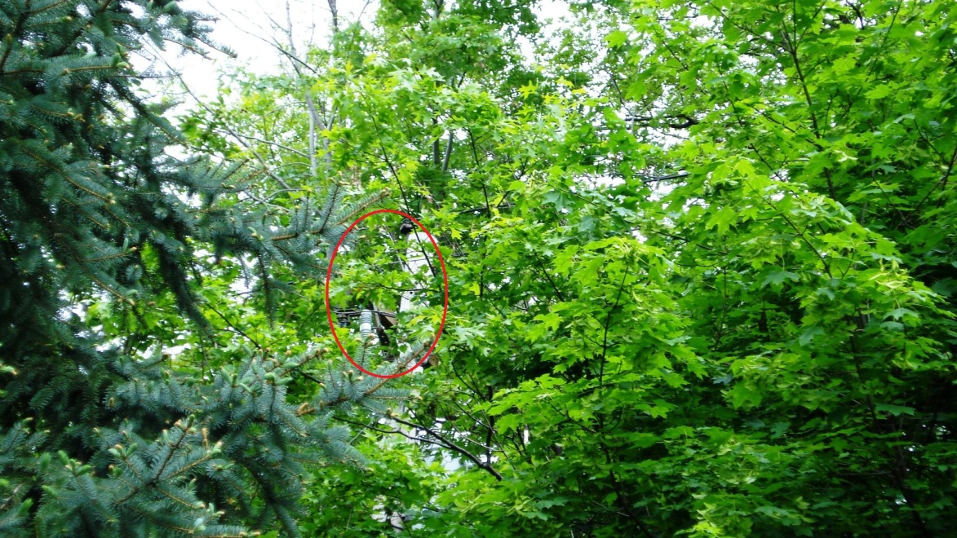
Independent Line Clearance Inspections

Slide 25
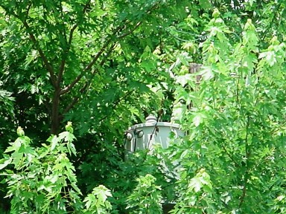

Slide 26
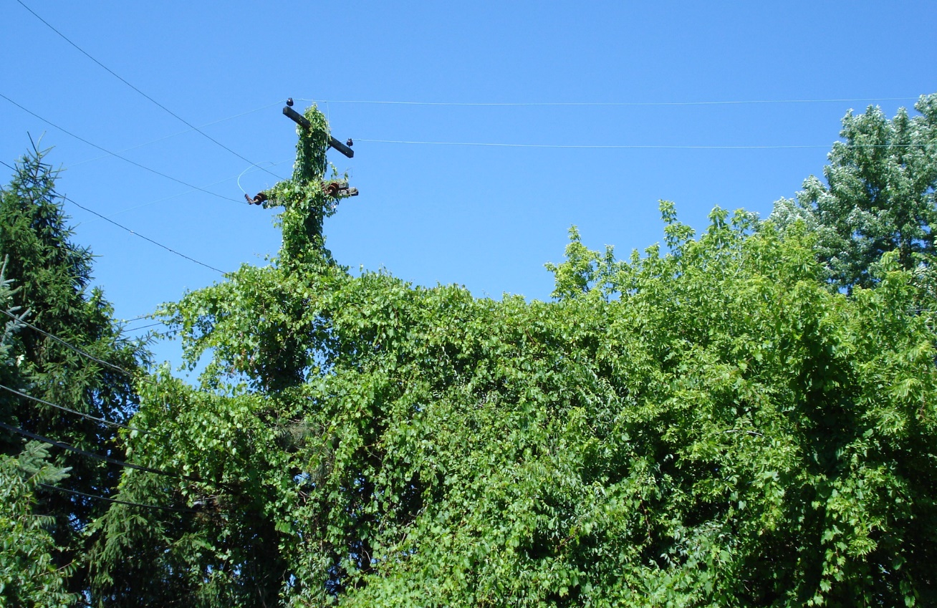

Slide 27
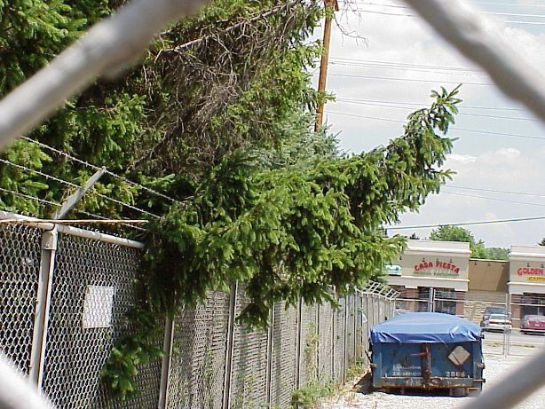

Slide 28
Notes:
Sample report related to a vegetation issue discovered during an independent inspection. Electric utility has 30 days to provide a response

Slide 29
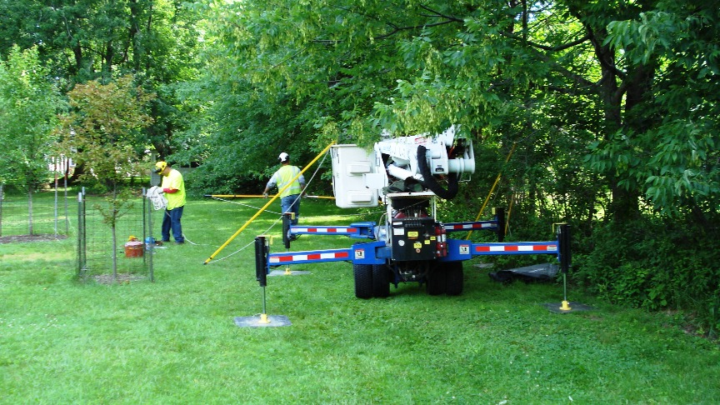
Crew Observance

Slide 30
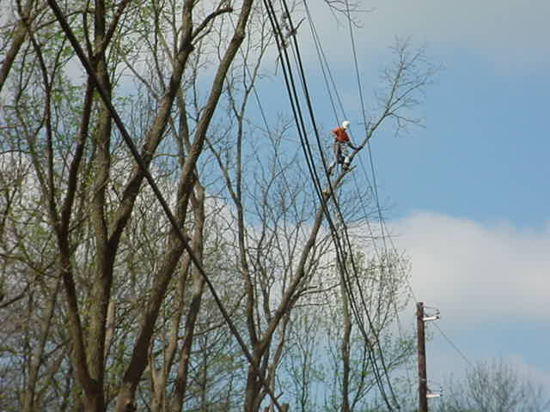

Slide 31
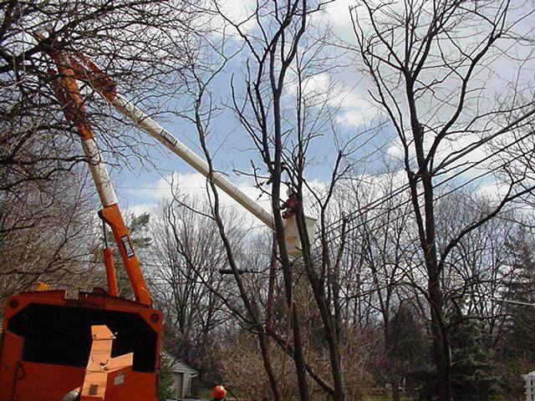

Slide 32
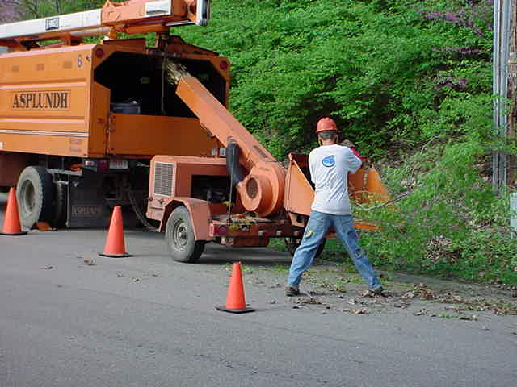

Slide 33
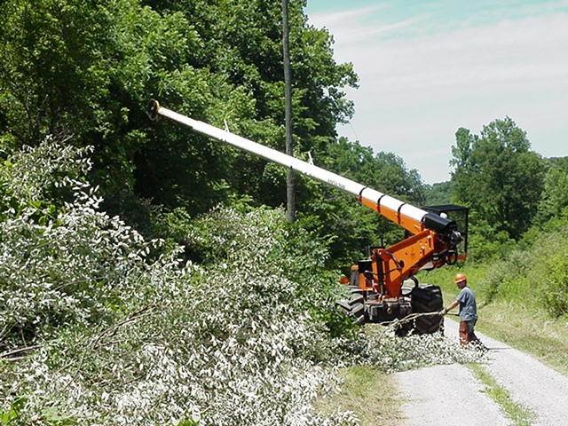

Slide 34
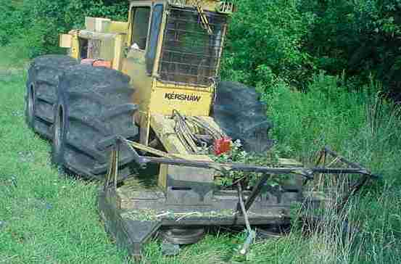

Slide 35
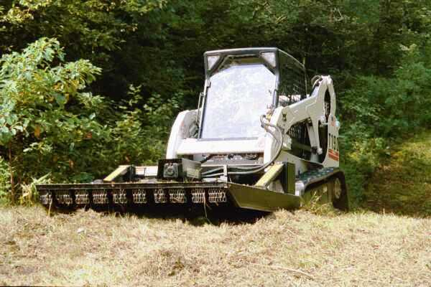

Slide 36
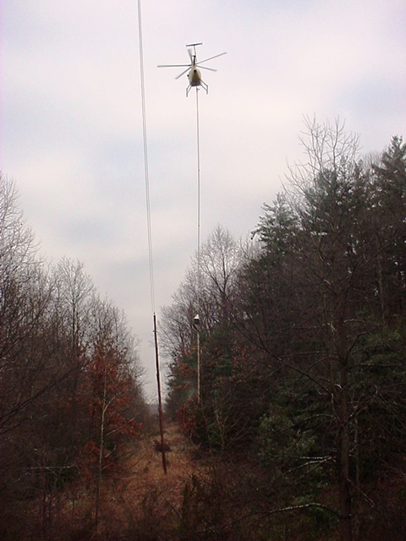

Slide 37
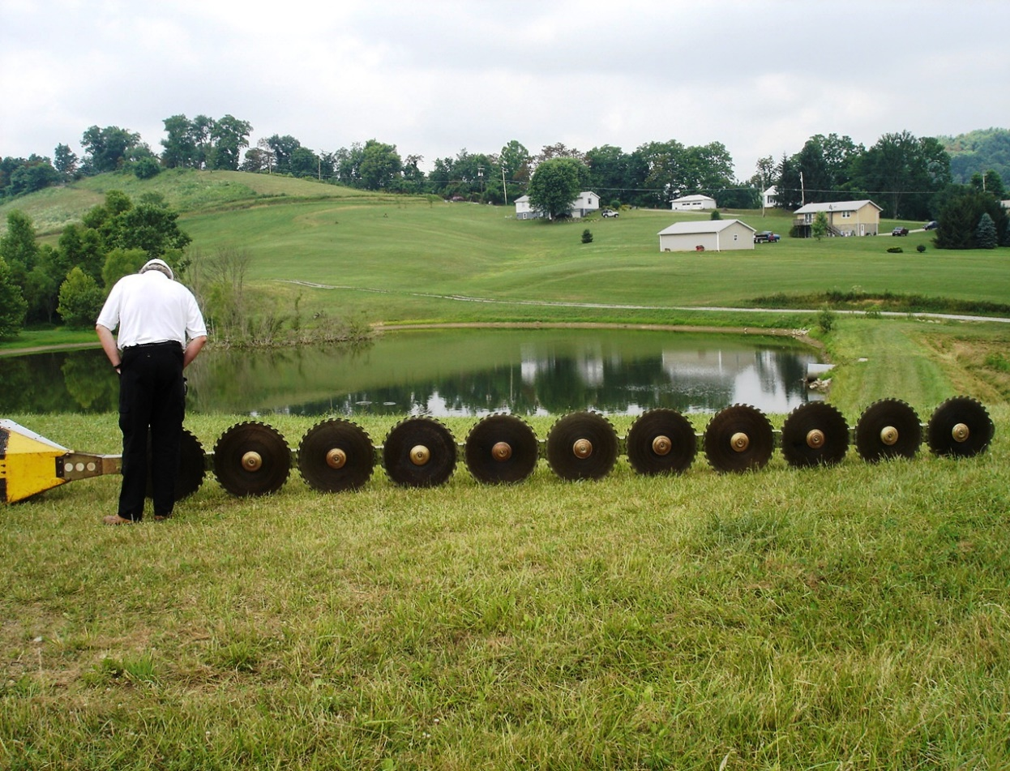

Slide 38
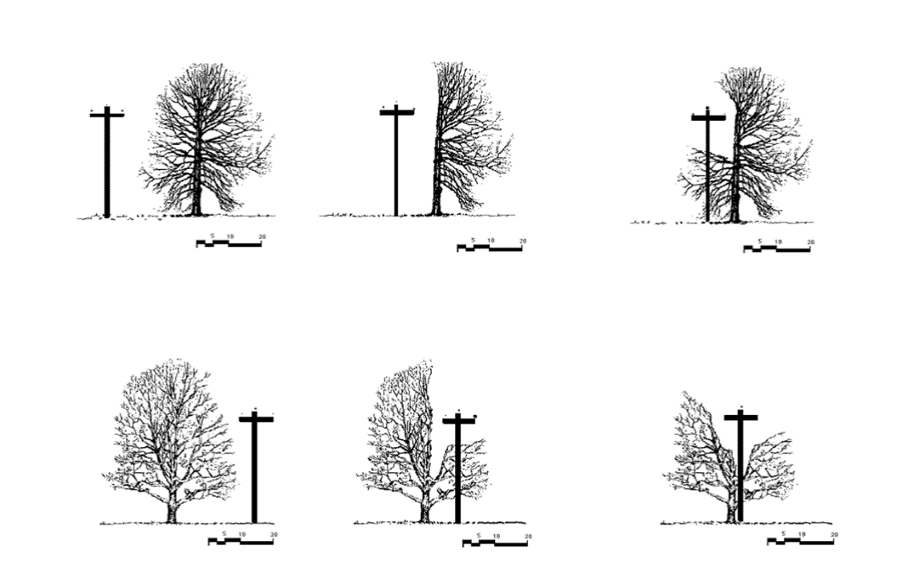
Line Clearance Audit With Electric Utility Forester

Slide 39
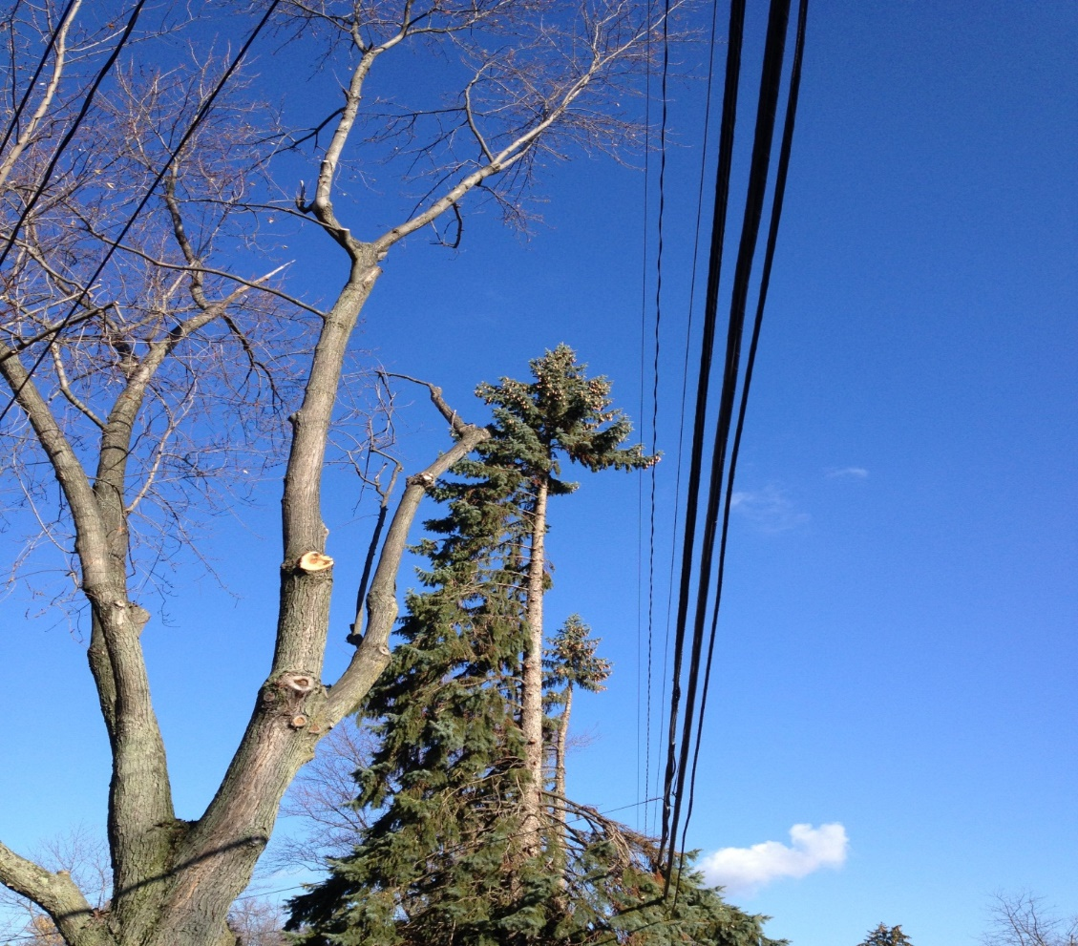

Slide 40
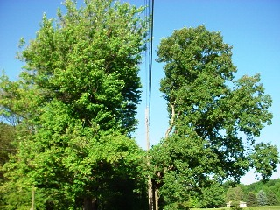

Slide 41
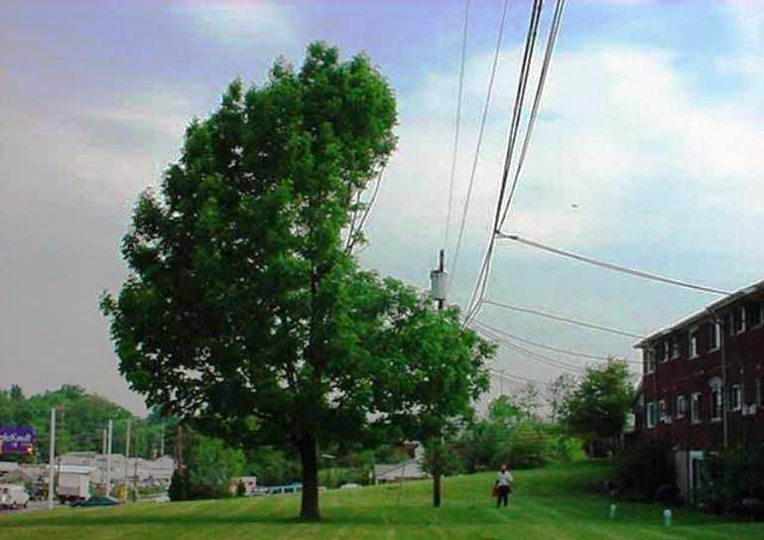

Slide 42
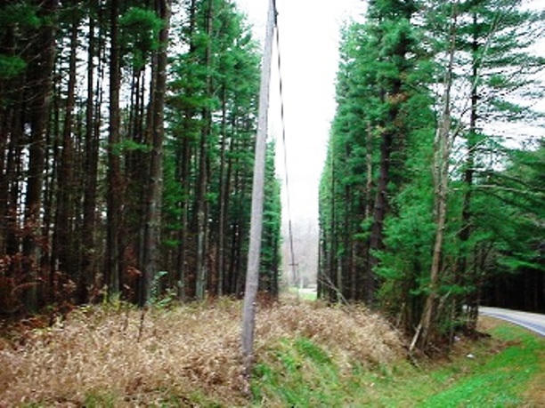

Slide 43
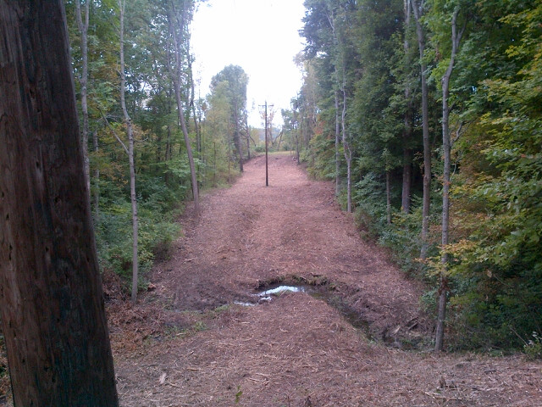

Slide 44
Office Audits
Review for accuracy and completeness
Circuit maps
Timesheets
Vegetation database
Refusal and skip issues
Scheduled and completed circuits and or miles
Notes:
PUCO Staff conduct on site vegetation management office audits. The audit involves reviewing the following documents and records related to completed line clearance work:

Slide 45
Summary
Public Utility Defined
Regulated Electric Utilities
Jurisdiction and Authority
Program Maintenance and Inspection Requirements
Call Center
Audits and Investigations
Contact Information
  Lowell Miller, Field Staff Manager
  614-644-8985 (w)
  614-314-0079 (c)

