Slide 1
IR/WA Appraisal Day 2021
Wetland and Stream Regulations in Ohio:
Permitting Mechanisms in Ohio that Allow Regulated Lands to be Utilized for Various Uses
Brandon Beck
Ohio Environmental Protection Agency
May 11, 2021

Slide 2
Overview
Applicable Rules and Laws
Wetland and Stream Identification
Permitting Process
Associated Costs
Potential Opportunities

Slide 3
Applicable Rules and Laws
Clean Water Act (CWA)
  Federal Water Pollution Control Act of 1972
  Sections 404 and 401
Ohio Revised Code (ORC)
Ohio Administrative Code (OAC)

Slide 4
Clean Water Act
Section 404
  Regulates the placement of dredged or fill material into waters of the United States
  Administered by the United States Army Corps of Engineers (USACE, Corps)
  Corps issues jurisdictional determination (JD) to determine if the aquatic resource is regulated by the Clean Water Act

Slide 5
Clean Water Act
Section 401
  Regulates the placement of dredged or fill material into waters of the United States
  Administered by the Ohio Environmental Protection Agency (Ohio EPA) in the State of Ohio
  A Section 401 Water Quality Certification is the State of Ohio’s way of certifying that a project will not violate the State’s Water Quality Standards.

Slide 6
Ohio Revised Code and Ohio Administrative Code
Ohio Revised Code
  ORC
  State Laws
  Chapter 6111: Water Pollution Control
Ohio Administrative Code
  OAC
  State Agency Rules
  Water Quality Standards
    3745-1-01 through 39
  Wetland Water Quality Standards
    3745-1-50 through 54
  401 Water Quality Certifications
    3745-32-01 through 03

Slide 7
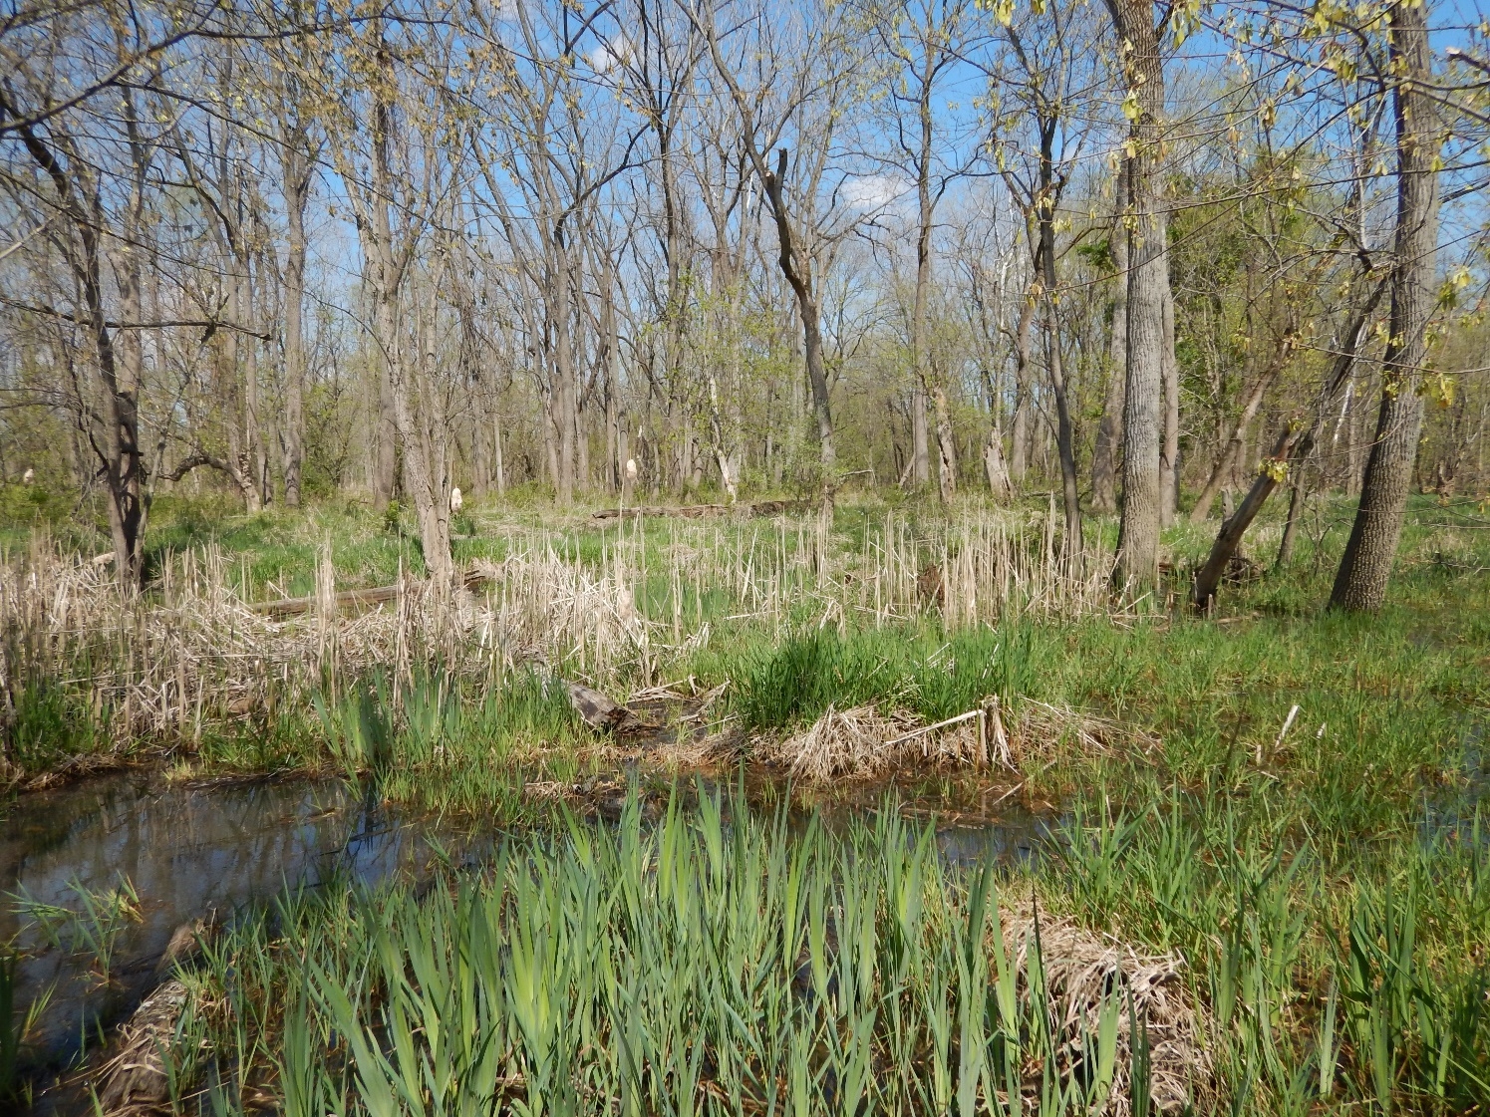
Wetland and Stream Identification

Slide 8
What is a Wetland?
ORC 6111.02 - "Wetlands" are those areas that are inundated or saturated by surface or ground water at a frequency and duration that are sufficient to support, and that under normal circumstances do support, a prevalence of vegetation typically adapted for life in saturated soil conditions. "Wetlands" includes swamps, marshes, bogs and similar areas that are delineated in accordance with the 1987 United States Army Corps of Engineers (Corps) wetland delineation manual and any other procedures and requirements adopted by the Corps for delineating wetlands.

Slide 9
Wetland Indicators
A wetland must have all three indicators:
  Hydric Soils
  Wetland Hydrology
  Dominance of hydrophytic vegetation

Slide 10
Hydric Soils
Soils that formed under conditions of prolonged saturation, flooding, or ponding long enough to develop anaerobic conditions in the upper layer
Prolonged lack of oxygen changes the chemical processes in the soil

Slide 11
Redoximorphic Features
Chemical processes that involve the reduction and oxidization of iron and/or manganese compounds resulting from prolonged saturation
Redox Concentrations
  Areas of iron and/or manganese oxide accumulations
Redox Depletions
  Areas where iron and/or manganese oxides have been stripped out of the soil due to iron and manganese mobility

Slide 12
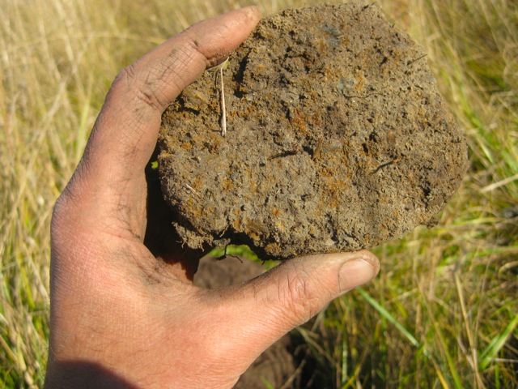
Redox Concentrations

Slide 13
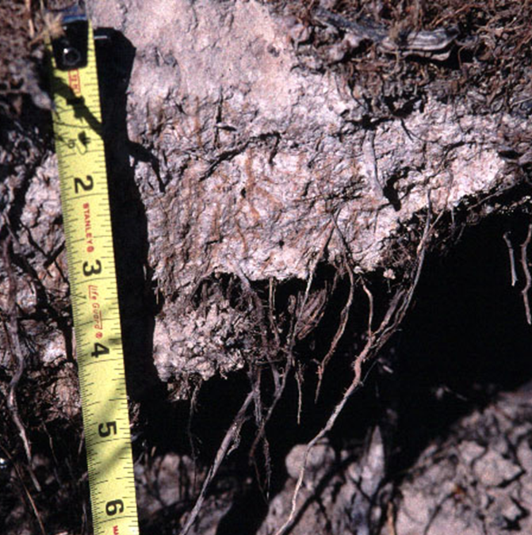
Redox Concentrations

Slide 14
Redox Depletions
Photo Credit – United States Army Corps of Engineers

Slide 15
Wetland Hydrology
Wetlands have flooded or saturated soils for at least part of the growing season
Direct observation of standing water or saturated soils may not be possible at all times during the year
  Summer months, dry years, etc.

Slide 16
Wetland Hydrology Indicators
Primary Indicators
Secondary Indicators
Surface Water
Saturation of Soils
Water Marks
Sediment / Drift Deposits
Inundation on Aerial Imagery (Google Earth)
Oxidized Rhizospheres Along Living Roots
Water-Stained Leaves
Surface Soil Cracks
Moss Trim Lines
Crayfish Burrows
Saturation on Aerial Imagery
Geomorphic Position

Slide 17
Hydrology Indicator Photos
Water Marks
Drift Deposit
Photo Credit – United States Army Corps of Engineers

Slide 18
Hydrology Indicator Photos
Moss Trim Line
Water-Stained Leaves
Photo Credit – United States Army Corps of Engineers

Slide 19
Hydrology Indicator Photos
Inundation and Saturation on Aerial Imagery

Slide 20
Hydrophytic Vegetation
Plant community is dominated by species that require or can tolerate prolonged inundation or soil saturation during the growing season
Wetland Indicator Status
  Obligate (>99% probability)
  Facultative Wetland (67%-99%)
  Facultative (34%-66%)
  Facultative Upland (1%-33%)
  Upland (<1%)

Slide 21
Common Wetland Plants
Carex frankii (Frank’s Sedge)
Carex grayi
(Gray’s Sedge)
Carex vulpinoidea
(Fox Sedge)

Slide 22
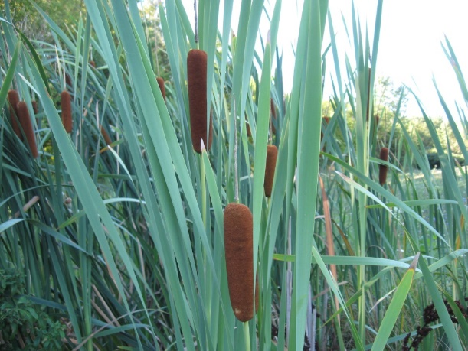
Common Wetland Plants
Typha angustifolia
(Narrow-Leaved Cattail)
Phalaris arundinacea (Reed Canarygrass)
Phragmites australis (Common Reed)

Slide 23
Categories of Wetlands in Ohio
Category 1
  Lowest quality
  Minimal functions and potential to improve
  Often dominated by invasive species and low species diversity
Category 2
  Moderate quality
  Dominated by natives, but without T&E species
Category 3
  highest quality
  Superior habitat and hydrological and recreational functions
  Contains high levels of species diversity and native vegetation
  May include presence of T&E species or T&E habitat
  Demonstration of public need to impact

Slide 24
Categorizing Wetlands
Ohio Rapid Assessment Method (ORAM)
  Quickest way to categorize (qualitative)
  6 different metrics
    Wetland Size
    Buffer Size and Surrounding Land Use
    Hydrology
    Habitat Alteration and Development
    Special Wetlands (Bogs, Fens, T&E species)
    Plant Communities
Vegetative Index of Biotic Integrity (VIBI)
  More difficult and expensive, data intensive (quantitative)
  More definitive and can override ORAM results

Slide 25
Stream Indicators
Defined bed and bank
Ordinary High Water Mark (OHWM)
  The line of the shore established by the fluctuations of water, and indicated by physical characteristics such as a clear, natural line impressed on the banks
  Indicators include shelving, changes in soil characteristics, destruction of vegetation, and presence of a litter / debris line
  Regulatory authority begins at OHWM

Slide 26
OHWM Indicator
Photo Credit – Ohio Department of Transportation

Slide 27
Types of Streams
Perennial
  Larger streams that flow year-round during years of normal rainfall
Intermittent
  Medium-sized streams that flow during the wetter seasons
  May not have any surface water flow during the drier months
Ephemeral
  Flow in direct response to precipitation events (rain or melting snow), otherwise may lack flow

Slide 28
Stream Classifications and Designations
Coldwater Habitat
Exceptional Warmwater Habitat
  Less than 10% of streams in Ohio
Warmwater Habitat
  Most common
Modified Warmwater Habitat
  Acid mine drainage, ditching, damming
Limited Resource Water
  Lowest quality, degraded

Slide 29
Stream Assessments
Qualitative Habitat Evaluation Index (QHEI)
  Describes a stream’s potential to support fish populations based on habitat characteristics
Index of Biotic Integrity (IBI)
  Evaluation of the fish populations
Invertebrate Community Index (ICI)
  Evaluation of the stream’s macroinvertebrate (bug) populations

Slide 30
Permitting Process
Activities that trigger the need for a 404 permit / 401 certification
  Placing fill below the ordinary high-water mark of a surface water (streams, lakes)
  Placing fill within the boundaries of a wetland
  Mechanized land clearing
  Housing developments, industrial sites, recreational facilities, roads, utility lines, etc.

Slide 31
Permitting Process
Determine if your project will impact a wetland or other surface water
  Usually beneficial to hire a professional environmental consultant to perform a wetland and stream delineation and assessment
  Hiring a professional isn’t required. At a minimum, someone with knowledge of soils and local plants should perform the delineation
Send the delineation to the Army Corps so they can issue a jurisdictional determination (JD)
  Federally Jurisdictional or Non-Jurisdictional (Isolated)

Slide 32
Types of Permits
Federal Permits
  General Permit
    Nationwide Permits
  Individual 404 Permit
State Permits
  General Permits
    Level 1 Isolated Wetland and Ephemeral Stream GP
  Individual Permits
    Level 2 and Level 3 Isolated Wetland Permit
    Individual 401 Water Quality Certification

Slide 33
Nationwide Permits
Activity Specific
  NWP 12: Utility Line Activities
  NWP 13: Bank Stabilization
  NWP 14: Linear Transportation Project
  NWP 21: Surface Coal Mining
  NWP 29: Residential Developments
  NWP 51: Land-Based Renewable Energy Facilities
Minimal Adverse Impact on Aquatic Environment
  < 0.5 acres of wetland impact
  < 500 linear feet bank stabilization

Slide 34
Nationwide Permits
Ohio EPA issues a 401 Water Quality Certification to the U.S Army Corps for their NWPs
Project must comply with all terms and conditions of the applicable NWP
  State and Federal conditions
Recommended that you contact the Corps first to see if you qualify for NWP coverage

Slide 35
Nationwide Permits
If your project exceeds or does not meet 401 (state) conditions, you must apply for an Individual 401 or a Director’s Authorization
Director’s Authorization: any project that does not meet one or more of the terms and conditions for eligibility under the 401 WQC or where the district engineer has been granted authority to waive certain requirements, Ohio EPA may determine, that a project will have such a minimal impact on water quality that individual state WQC is not necessary provided all other terms and conditions of the NWP certification have been met

Slide 36
Isolated Wetland Permits
Level 1 IWP
  Less than 0.5 acre of impact to Category 1 and Category 2 wetlands
Level 2 IWP
  Greater than 0.5 acre of impact to Category 1 wetlands
  Greater than 0.5 acre of impact, but less than 3 acres of impact to Category 2 wetlands
Level 3 IWP
  Greater than 3 acres of impact to Category 2 wetland
  Any amount of impact to Category 3 wetlands

Slide 37
401 Water Quality Certification (WQC) Process
Must request a pre-filing meeting request at least 30 days prior to 401 application submission
Ohio EPA has 15 business days to perform an administrative review of the application
  If Incomplete, a list of deficient items
  If Complete, public notice process will begin
  30 day public notice period, 45 day period if a public hearing is required

Slide 38
401 WQC Process
Technical Review begins once application is administratively complete and public noticed
180 days from date of complete to take an action
  Issue or Deny
Maximum of 365 days from date of application receipt to take an action
  Federal agency (Army Corps) will establish their “reasonable period of time” for the certifying authority (Ohio EPA) to take an action
Corps will take an action once the 401 WQC is issued

Slide 39
Permitting Process
Non-jurisdictional water (i.e., isolated wetland or ephemeral stream)
Isolated wetland or ephemeral stream permit from Ohio EPA
NWP from Corps, covered under general 401 WQC from Ohio EPA. Individual 401 WQC not required.
Site Assessment
Jurisdictional determination from Corps
Individual 401 from Ohio EPA and 404 from Corps
Jurisdictional water
NWP from Corps, not covered under general 401 WQC from Ohio EPA. Individual 401 WQC required.
Nationwide Permit (NWP)
NWP from Corps, not covered under general 401 WQC from Ohio EPA, but Director’s Authorization granted.

Slide 40
Compensatory Mitigation
Applicants must provide compensatory mitigation to offset their impacts to water quality
Mitigation Hierarchy
  Mitigation bank within the same watershed as impacts
  In-lieu fee program within the same watershed
  Permittee-responsible (individual mitigation projects) within the watershed

Slide 41
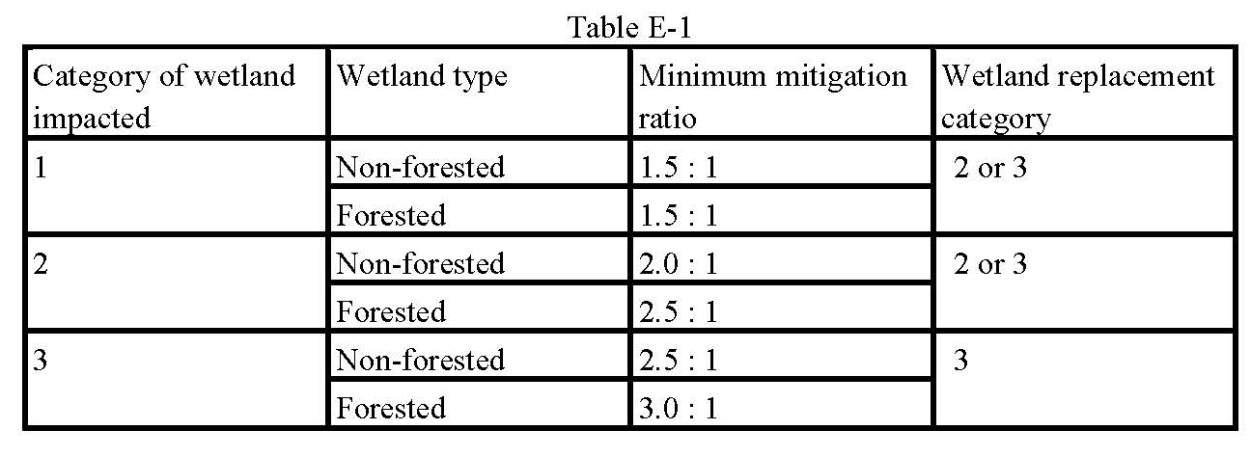
Compensatory Mitigation
Conducted in accordance with OAC 3745-1-54 (Wetland Antidegradation)

Slide 42
Mitigation Costs
Mitigation costs vary by watershed location, type of wetland, mitigation provider, watershed demand, etc.
Wetland Credits
  $35,000-$75,000 per acre of wetland
Stream Mitigation
  ~$250 per linear foot

Slide 43
Fees
Permit Type | Application Fee | Review Fee | Fee Cap | Fees Due
401 Water Quality Certification (Fees do not apply to state agencies or the U.S. Army Corps) | $200.00 | Wetland $500/acre | $25,000 ($5,000 for county, township or municipal corporation) | Application fee and ½ of review fee at time of application, remainder due when director takes an action
 |  | Intermittent Stream $10/linear foot
 |  | Perennial Stream $15/linear foot
 |  | Lake $3/cubic yard
Isolated Wetland and Ephemeral Stream Permit (Fees do not apply to state agencies, counties, townships or municipal corporations) | $200.00 | Wetland $500/acre (Doubled for after the fact permits) No review fee for Ephemeral Streams | $5,200 (Review fees cap = $5,000) | All fees due at time of application
Director’s Authorization (Fees do not apply to state agencies or the U.S. Army Corps) | NA | $2,000.00 | $2,000.00 | All fees due at time of application

Slide 44
Potential Opportunities
Mitigation Banking
  Potential to sell existing wetland credits
  Enhancement of existing wetlands
  Re-establishment of former wetlands
  Administered by the Ohio Interagency Review Team (IRT)
Institutions that value natural areas
  Private/non-profit land conservancy groups
  Governmental agencies

Slide 45
Questions?
Brandon Beck
Division of Surface Water
Phone: (614) 644-2259
Fax: (614) 644-2745
Brandon.Beck@epa.ohio.gov

