Slide 1
IRWA UTILITY DAY SEMINAR
Underground Distribution Right of Way Challenges and Successes
January 12, 2021
Garrett Gill – Executive Vice President, Power Group
Contract Land Staff

Slide 2
Topics of Discussion
Benefits of Underground Distribution
Examples of Equipment
Challenges of Negotiation
Keys to Success

Slide 3
Benefits of Underground Distribution

Slide 4
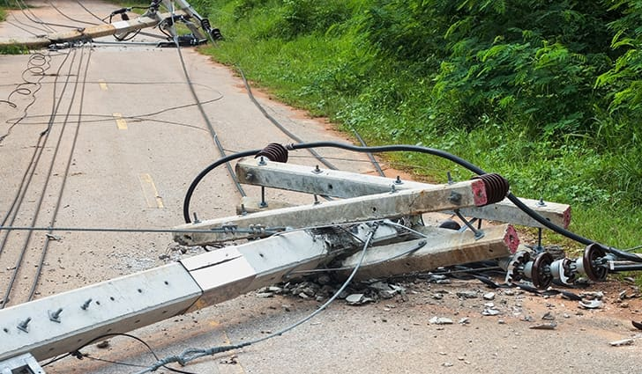
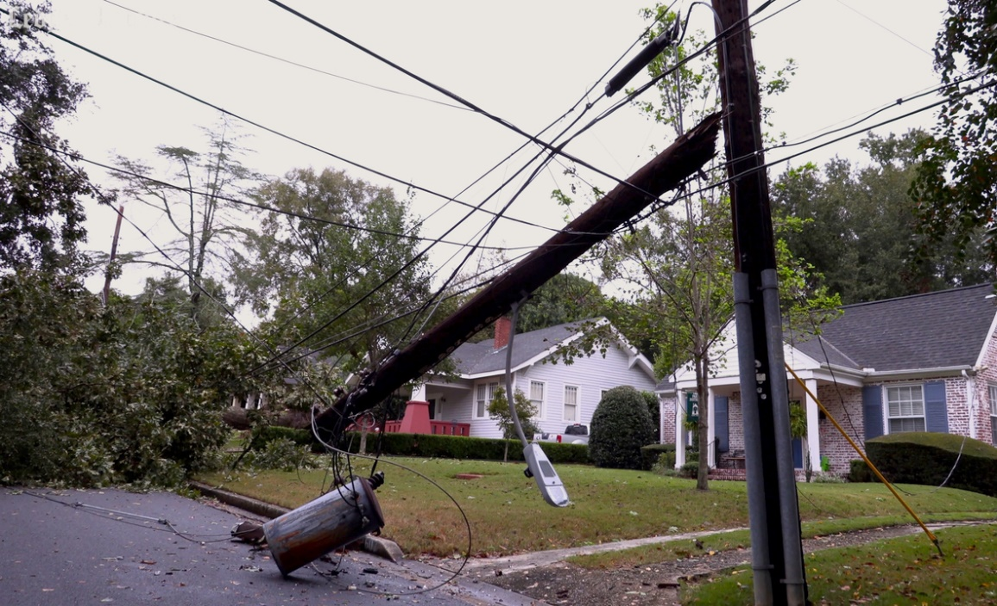

Slide 5
Benefits of Underground Distribution
Improve the quality of electric service
Minimize service interruptions
Increase safety in the service area following an extreme weather event
Restore power more quickly following major storms

Slide 6
Examples of Equipment

Slide 7
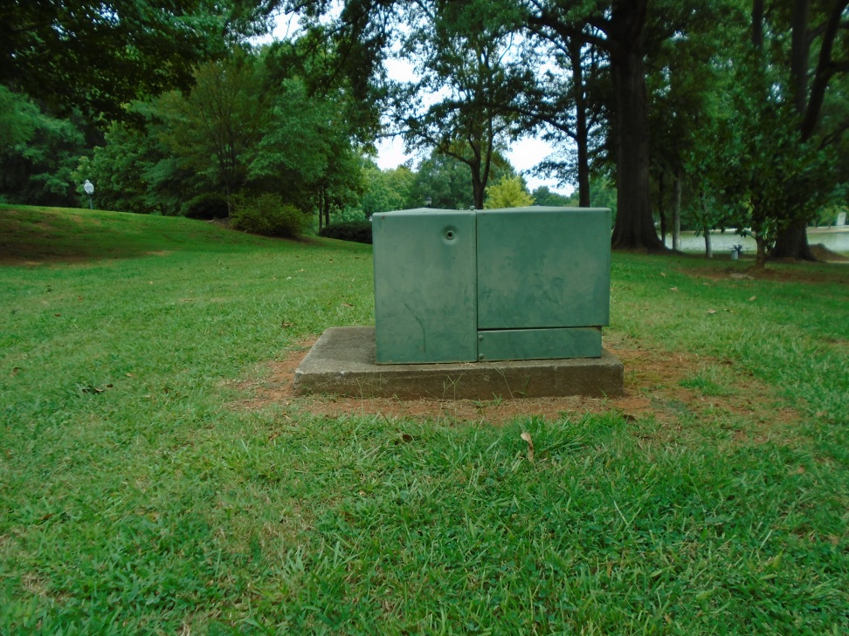
Examples of Equipment
Single Phase Padmount Transformer
Notes:
This equipment is used to step down the single-phase primary voltage to a secondary voltage to deliver power to your home.

Slide 8
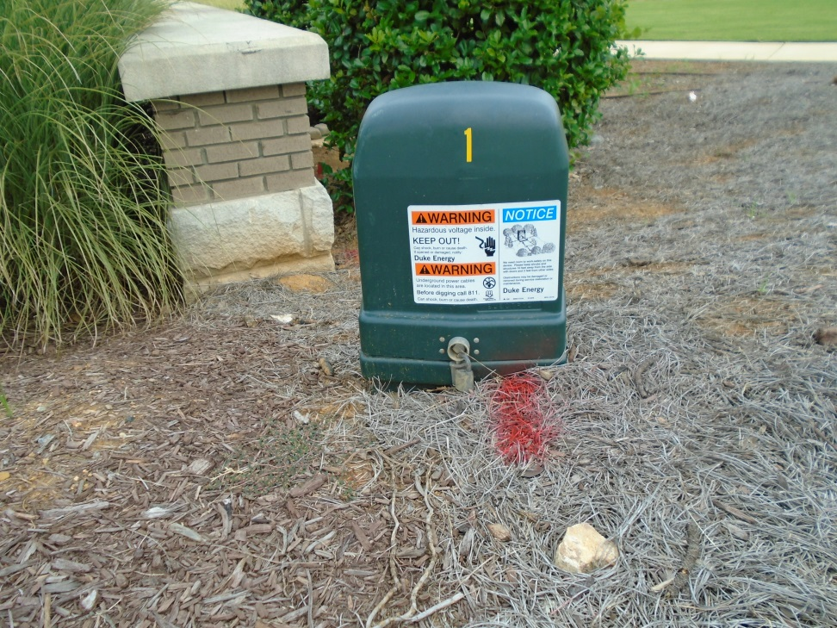
Examples of Equipment
Above Ground Pedestal
Notes:
This is a junction box for secondary and service conductors.

Slide 9
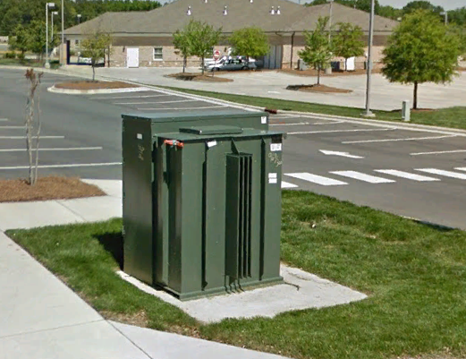
Examples of Equipment
3-phase Padmount Transformer
Notes:
This equipment is used to step down the three-phase primary voltage to a secondary voltage to deliver power for businesses (not for residential homes typically)

Slide 10
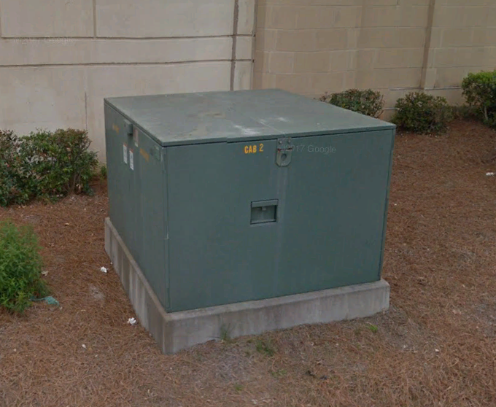
Examples of Equipment
Switchgear
Notes:
This is a junction box for primary conductors and are potentially used in large commercial or residential areas along the main route of the cables.

Slide 11
Challenges with Negotiation

Slide 12
Challenges with Negotiation
Not all parties agree – The overhead line may be serving several properties but located on only half of the properties. If approval cannot be acquired from all property owners, and a redesign is not possible, an entire work order could potentially be cancelled.
Difficult landowners – Landowners may be difficult to engage with either due to a past negative experience with the electrical company, or a negative perception of the electrical company.

Slide 13
Challenges with Negotiation
Above Ground Equipment – Landowners have difficulty accepting the visible equipment scoped on their property to convert their overhead distribution to underground. As the saying goes, “everyone wants UG service, but no one wants the equipment needed for it”.
Joint Use Issues: (Poles remain along with some overhead lines). Utilities should get ahead of this issue by working closer with other utilities.

Slide 14
Challenges with Negotiation
New Homeowners: Owners who have recently purchased the homes (2 yrs. or less) have not experienced outages monitored within the researched timeframe. They do not understand the need to UG the lines, making them less likely to accept equipment for the project to proceed.
Construction changes – The landowner must be re-engaged with to ensure they approve of any construction directed changes that occur after the acquisition phase.

Slide 15
Keys to Success

Slide 16
Keys to Success
Public Outreach: Connect, inform, and get feedback from the local community and/or customers.
Training: Quality training for all employees on Company’s overall objective and strategy for negotiations, unresponsive landowners, landowners that elect to decline, or legal matters that inhibit the ability to acquire the easement rights.

Slide 17
Keys to Success
Construction Design: Ensure all stakeholders are well informed with primary and alternative locations for equipment and routing of the underground lines.
Stakeholder Communication: Open meetings with all stakeholders to review concerns early on, assist with gathering options to maintain acquisition success.

Slide 18
Questions?

